Slide 1
Community High
2899 Fox Hill Sterling Heights, MI 48310 586.825.2900 FAX 586.698.4304

Slide 2
WCS Graduation Requirements
GRADE | 9th | 10th | 11th | 12th | CREDITS
ELA | 9 | 10 | 11 | 12 | 4
MATH | ALG 1 | GEO | ALG 2 | 4TH YEAR* | 4
SCI | BIO | CHEM/PHYSICS | 3RD YEAR* |  | 3
SS | AH | WH | ECO & GOVT |  | 3
PE |  |  |  |  | 0.5
HEALTH |  |  |  |  | 0.5
WL | SPANISH I | SPANISH I | SPANISH II | SPANISH II* | 2
VPA |  |  |  |  | 1
ELECTIVES |  |  |  |  | 4.5
TOTAL |  |  |  |  | 22.5

Slide 3
How many credits should I have?
9th- 6 credits Mid year: 3 credits
10th-6 credits Mid year: 9 credits
11th-6 credits Mid year: 15 credits
12th-6 credits Mid year: 21 credits
Total opportunity to earn 24 credits

Slide 4
Traditional Credit Recovery
You may earn 3 credit recovery credits from outside sources.
American School;
Keystone;
WCS Summer School
Drawback: $$$$$$$$$$

Slide 5
What can we do for you?
John Smith
 | QTR 1 | QTR 2 | FINAL | FINAL GRADE | CREDIT
ELA | D | F | F | F | 0
ALG 1 | F | C | C | D | 0.5
BIO | D | D | F | F | 0
AH | F | B | F | F | 0
PE | A | A | A | A | 0.5
SPANISH I | D- | F | D | F | 0
TOTAL |  |  |  |  | 1

Slide 6
John Smith
 | QTR 1 | QTR 2 | FINAL | FINAL GRADE | CREDIT
ELA | D | F | F | F | .25
ALG 1 | F | C | C | D | 0.5
BIO | D | D | F | F | .5
AH | F | B | F | F | .25
PE | A | A | A | A | 0.5
SPANISH I | D- | F | D | F | .25
TOTAL |  |  |  |  | 2.25

Slide 7
Credit Recovery-Electives
Work Study- Students can earn .50 credits per quarter (2.0 credits per year).
Community Service- (can be earned over summer).Students can earn .50 credits for every 60 hours of community service, with a maximum of 2.0 credits (240 hours).
Life Skills Seminar Program- Community High School will offer 10-15 opportunities to attend presentations and educational seminars focused on Life Skills and Healthy Living.
Winning Futures Mentoring Program- .50 credit

Slide 8
Other CR options
Keystone/American School…etc $$$$$
WCS summer school $$$$$$
Online CR for core classes $$$$$
Macomb Community College Summer programs

Slide 9
Career Prep Center
Many students attend the Career Prep Center during A block for an additional credit each year.
Most qualify for 4th Math Credit and additional VPA class
Schedule looks like:
Hours 1-2 at CPC, and hours 2-6 Community High

Slide 10
Other information
Hours: 7:58 am – 2:57 pm
Same Lunch Program
Transportation from home school and back
Transportation to/from CPC
Smaller class sizes; most under 23
Approximately 175 students
Participation in ALNET athletics- basketball, volleyball, quiz bowl, softball, Cedar Pointe
High School diploma with commencement ceremony-Must take SAT/M-Step
Days coordinate with traditional high schools
Senior Award Program- Graduation Walk with Holden

Slide 11
Expectations
We Live By The Mantra:
Be Present
Be Productive
Be Positive
Students must pass 4/6 classes and maintain proper attendance to continue each quarter
Dismiss approx. 11-15 students every card marking due to lack of meeting expectations
If dismissed, may return if they complete a credit of community service or credit recovery course

Slide 12
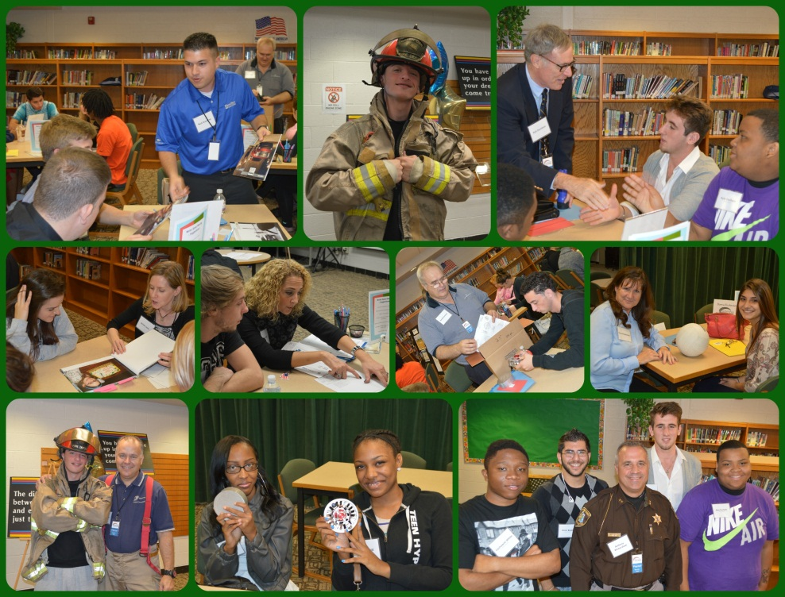
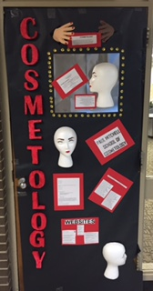
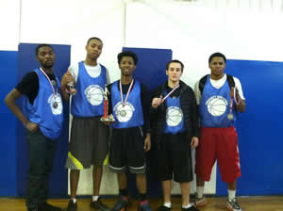
1 Quarter and 2nd Quarter Work Window Deadlines Ms. Padesky, Ms. West, Ms. Haffey, Ms. Collins, Mr. Kyewski
Late Work Window #1 Ends | Friday, September 18th
Late Work Window #2 Ends | Friday, October 2nd
Late Work Window #3 Ends | Friday, October 16th
Late Work Window #4 Ends | ***Friday, October 30^{th***}
Late Work Window #5 Ends | Friday, November 20th
Late Work Window #6 Ends | Friday, December 11th
Late Work Window #7 Ends | Friday, January 8th
Late Work Window #8 Ends | ***Friday, January 15^{th***}

Slide 13
Next Steps
Speak with you HOME SCHOOL counselor first
Information:
Brenda Tourtillott
586-825-2900 ext. 29907
Finish strong the next couple weeks

Slide 14
Questions

